Slide 1
One Lane Traffic Flow Models
Josh Hallam

Slide 2
What is traffic flow?
Traffic flow is the study of interactions between vehicles, drivers, and infrastructure (including highways, signage, and traffic control devices), with the aim of understanding and developing an optimal road network with efficient movement of traffic and minimal traffic congestion problems.

Slide 3

One Lane Highway
WA Hwy 2

Slide 4
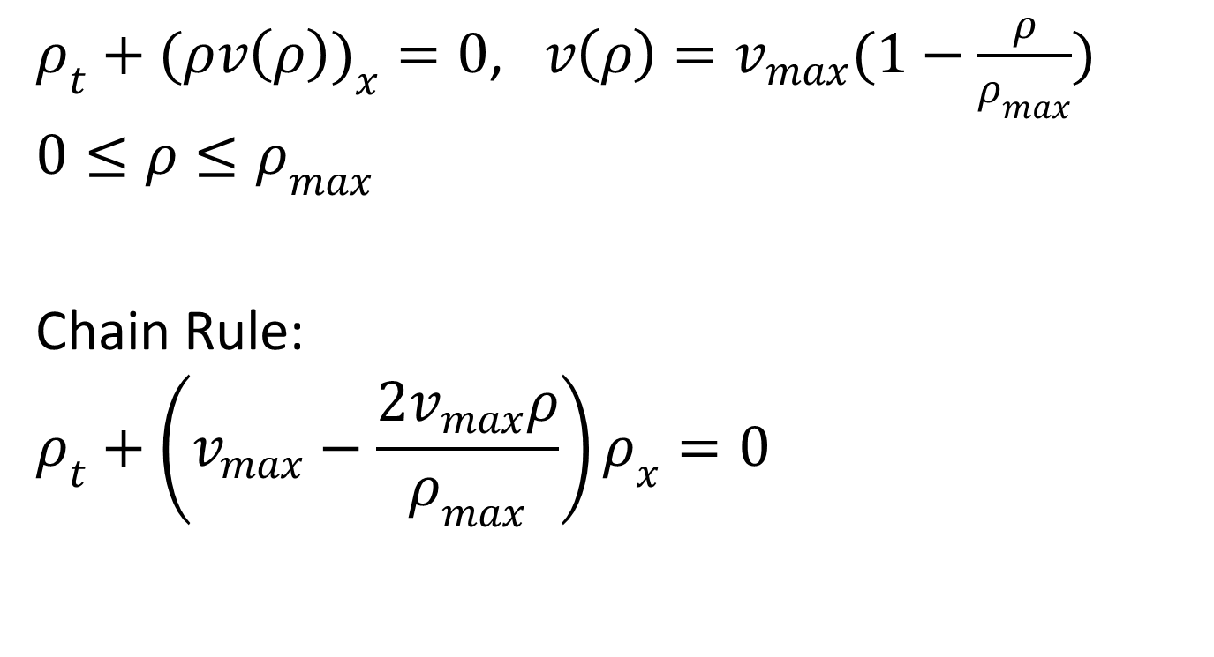
Lighthill-Whitham-Richards Model
$ρ_{t}+(ρv\left(ρ\right))_{x}=0$, $v\left(ρ\right)=v_{max}(1−\frac{ρ}{ρ_{max}})$
$$0≤ρ≤ρ_{max}$$
Chain Rule:
$$ρ_{t}+\left(v_{max}−\frac{2v_{max}ρ}{ρ_{max}}\right)ρ_{x}=0$$

Slide 5
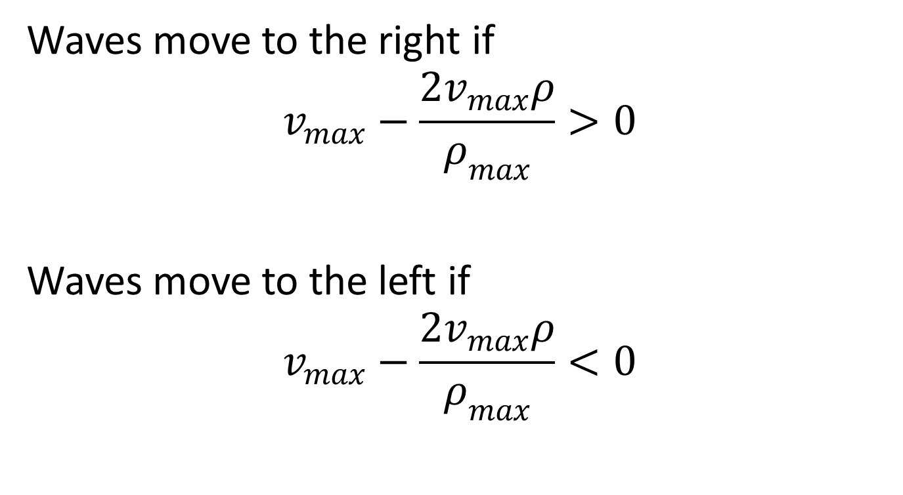
Lighthill-Whitham-Richards Model
Waves move to the right if
$$v_{max}−\frac{2v_{max}ρ}{ρ_{max}}>0$$
Waves move to the left if
$$v_{max}−\frac{2v_{max}ρ}{ρ_{max}}<0$$

Slide 6
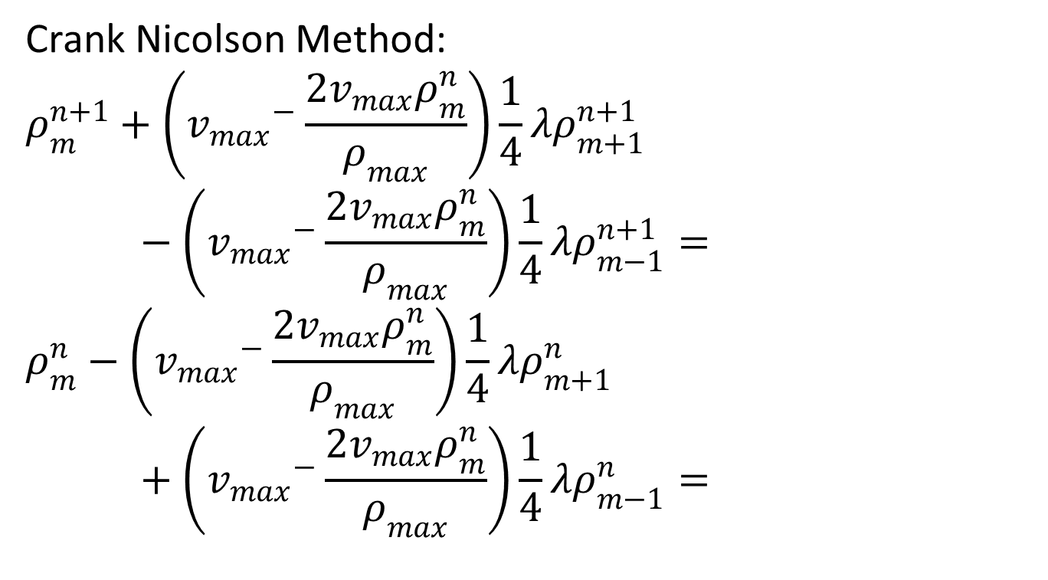
Lighthill-Whitham-Richards Model
Crank Nicolson Method:
$$ρ_{m}^{n+1}+\left({v_{max}}^{−}\frac{2v_{max}ρ_{m}^{n}}{ρ_{max}}\right)\frac{1}{4}λρ_{m+1}^{n+1}−\left({v_{max}}^{−}\frac{2v_{max}ρ_{m}^{n}}{ρ_{max}}\right)\frac{1}{4}λρ_{m−1}^{n+1}=$$
$$ρ_{m}^{n}−\left({v_{max}}^{−}\frac{2v_{max}ρ_{m}^{n}}{ρ_{max}}\right)\frac{1}{4}λρ_{m+1}^{n}+\left({v_{max}}^{−}\frac{2v_{max}ρ_{m}^{n}}{ρ_{max}}\right)\frac{1}{4}λρ_{m−1}^{n}=$$

Slide 7
Lighthill-Whitham-Richards Model

Slide 8
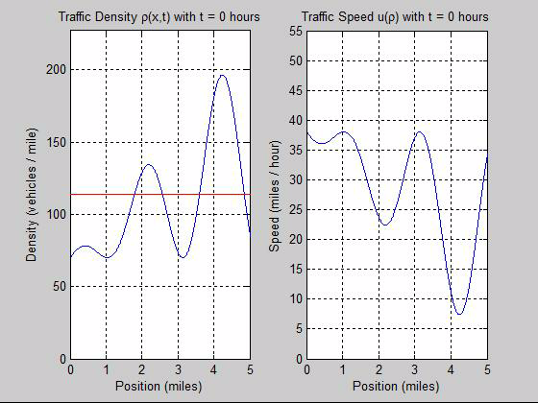
Lighthill-Whitham-Richards Model

Slide 9
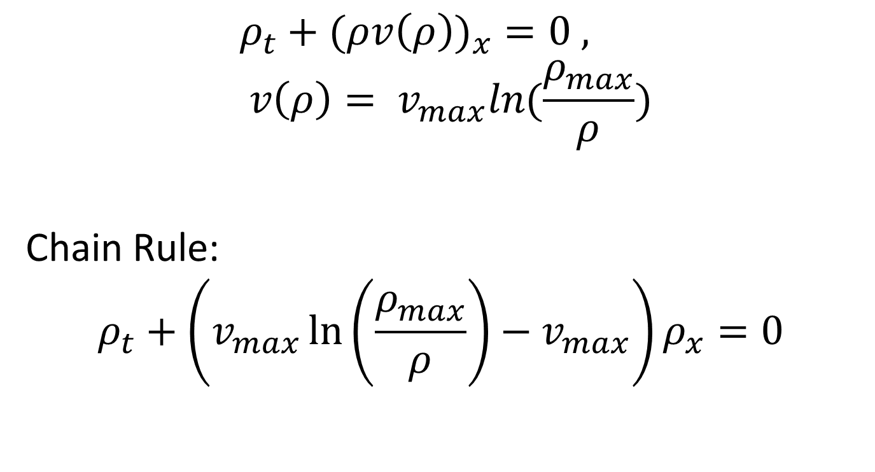
Greenberg Model
$$ρ_{t}+(ρv\left(ρ\right))_{x}=0 , v\left(ρ\right)= v_{max}ln(\frac{ρ_{max}}{ρ})$$
Chain Rule:
$$ρ_{t}+\left(v_{max}\ln\left(\frac{ρ_{max}}{ρ}\right)−v_{max}\right)ρ_{x}=0$$

Slide 10
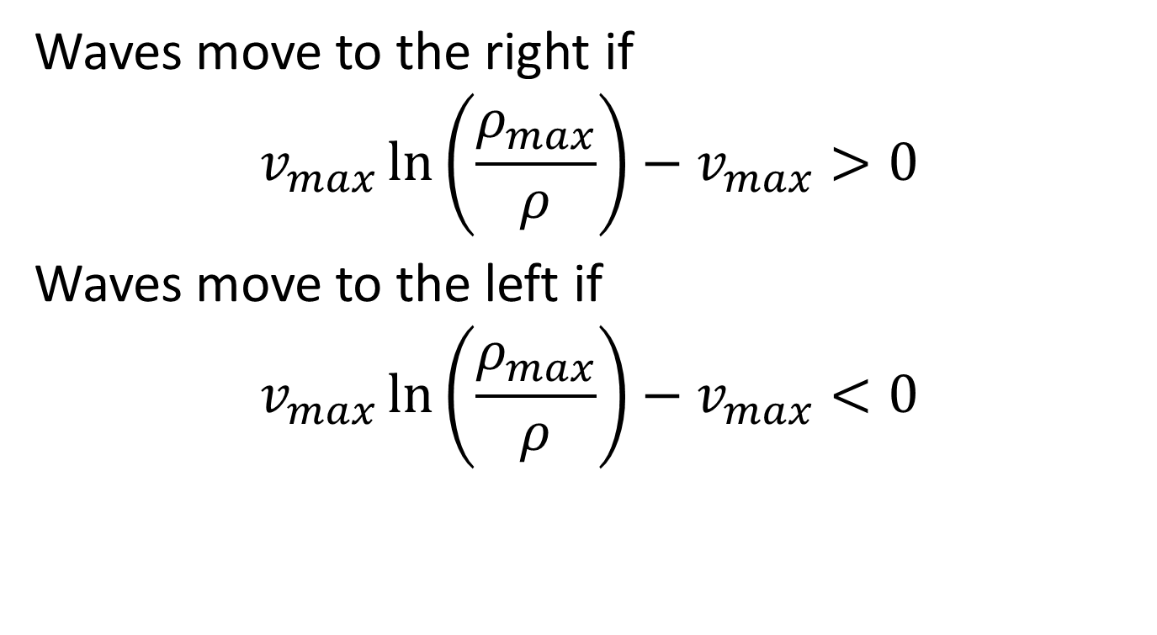
Greenberg Model
Waves move to the right if
$$v_{max}\ln\left(\frac{ρ_{max}}{ρ}\right)−v_{max}>0$$
Waves move to the left if
$$v_{max}\ln\left(\frac{ρ_{max}}{ρ}\right)−v_{max}<0$$

Slide 11
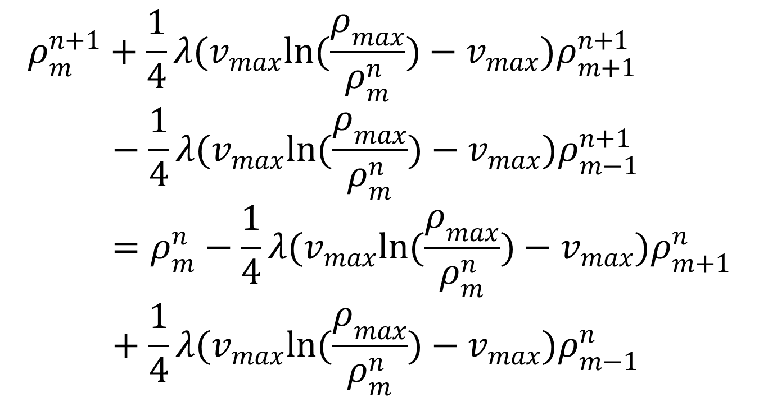
Greenberg Model
$$ρ_{m}^{n+1}+\frac{1}{4}λ(v_{max}ln(\frac{ρ_{max}}{ρ_{m}^{n}})−v_{max})ρ_{m+1}^{n+1}−\frac{1}{4}λ(v_{max}ln(\frac{ρ_{max}}{ρ_{m}^{n}})−v_{max})ρ_{m−1}^{n+1}=ρ_{m}^{n}−\frac{1}{4}λ(v_{max}ln(\frac{ρ_{max}}{ρ_{m}^{n}})−v_{max})ρ_{m+1}^{n}+\frac{1}{4}λ(v_{max}ln(\frac{ρ_{max}}{ρ_{m}^{n}})−v_{max})ρ_{m−1}^{n}$$

Slide 12
Greenberg Model

Slide 13
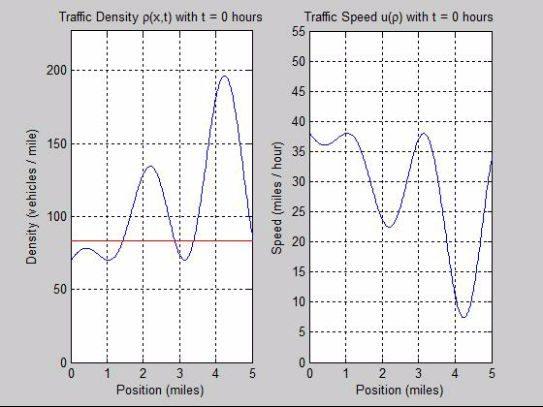
Greenberg Model

Slide 14
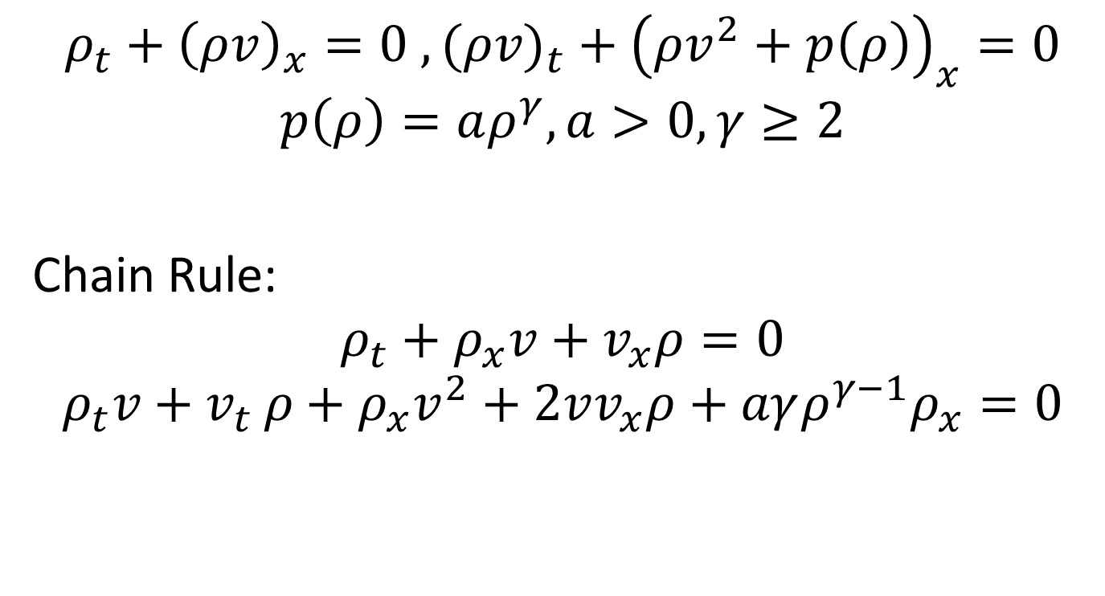
Payne-Whitham Model
$$ρ_{t}+{\left(ρv\right)}_{x}=0 ,(ρv)_{t}+{\left({ρv}^{2}+p\left(ρ\right)\right)}_{x}=0$$
$$p\left(ρ\right)=aρ^{γ}, a>0, γ≥2$$
Chain Rule:
$$ρ_{t}+ρ_{x}v+v_{x}ρ=0$$
$$ρ_{t}v+v_{t }ρ+ρ_{x}v^{2}+2vv_{x}ρ+aγρ^{γ−1}ρ_{x}=0$$

Slide 15
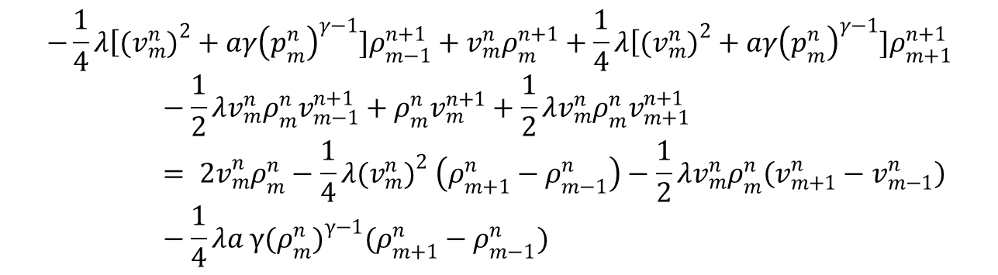
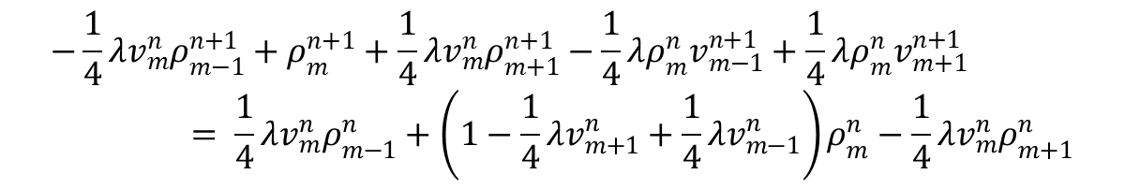
Payne-Whitham Model
(1)
(2)
$$−\frac{1}{4}λv_{m}^{n}ρ_{m−1}^{n+1}+ρ_{m}^{n+1}+\frac{1}{4}λv_{m}^{n}ρ_{m+1}^{n+1}−\frac{1}{4}λρ_{m}^{n}v_{m−1}^{n+1}+\frac{1}{4}λρ_{m}^{n}v_{m+1}^{n+1}= \frac{1}{4}λv_{m}^{n}ρ_{m−1}^{n}+\left(1−\frac{1}{4}λv_{m+1}^{n}+\frac{1}{4}λv_{m−1}^{n}\right)ρ_{m}^{n}−\frac{1}{4}λv_{m}^{n}ρ_{m+1}^{n}$$
$$−\frac{1}{4}λ\left[(v_{m}^{n}\right.)^{2}+aγ{\left(p_{m}^{n}\right)}^{γ−1}]ρ_{m−1}^{n+1}+v_{m}^{n}ρ_{m}^{n+1}+\frac{1}{4}λ\left[(v_{m}^{n}\right.)^{2}+aγ{\left(p_{m}^{n}\right)}^{γ−1}]ρ_{m+1}^{n+1}−\frac{1}{2}λv_{m}^{n}ρ_{m}^{n}v_{m−1}^{n+1}+ρ_{m}^{n}v_{m}^{n+1}+\frac{1}{2}λv_{m}^{n}ρ_{m}^{n}v_{m+1}^{n+1}= {2v}_{m}^{n}ρ_{m}^{n}−\frac{1}{4}λ(v_{m}^{n})^{2} \left(ρ_{m+1}^{n}−ρ_{m−1}^{n}\right)−\frac{1}{2}λv_{m}^{n}ρ_{m}^{n}\left(v_{m+1}^{n}−v_{m−1}^{n}\right)−\frac{1}{4}λa γ(ρ_{m}^{n})^{γ−1}(ρ_{m+1}^{n}−ρ_{m−1}^{n})$$

Slide 16
Payne-Whitham Model

Slide 17
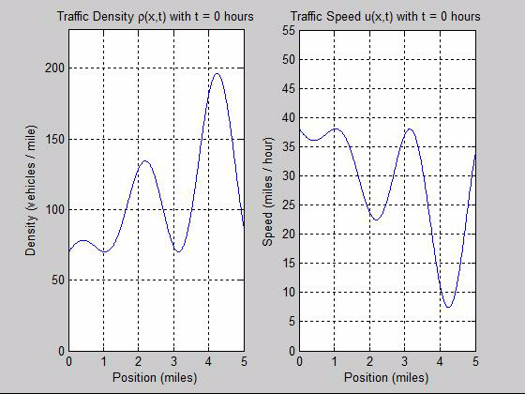
Payne-Whitham Model

Slide 18
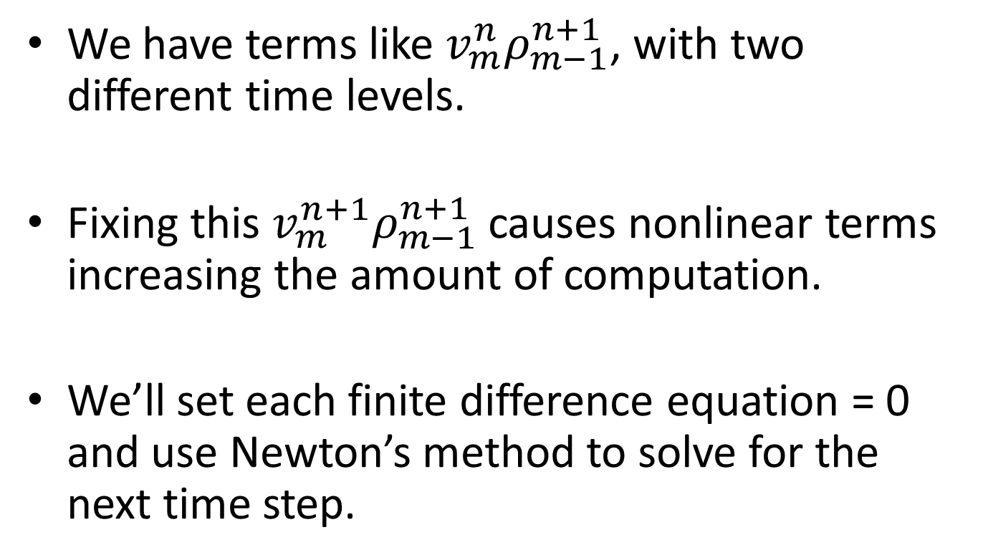
What is wrong here?
We have terms like $v_{m}^{n}ρ_{m−1}^{n+1}$, with two different time levels.
Fixing this $v_{m}^{n+1}ρ_{m−1}^{n+1}$ causes nonlinear terms increasing the amount of computation.
We’ll set each finite difference equation = 0 and use Newton’s method to solve for the next time step.

Slide 19
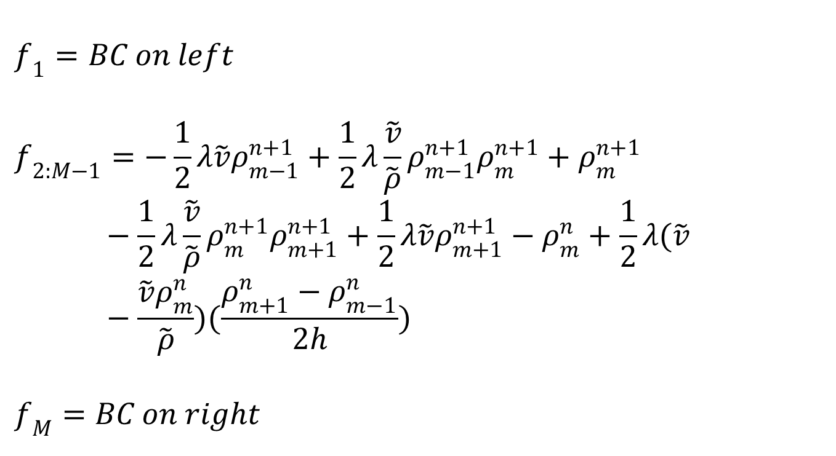
Lighthill-Whitham-Richards Model II
$$f_{1}=BC on left$$
$$f_{2:M−1}=−\frac{1}{2}λ\tilde{v}ρ_{m−1}^{n+1}+\frac{1}{2}λ\frac{\tilde{v}}{\tilde{ρ}}ρ_{m−1}^{n+1}ρ_{m}^{n+1}+ρ_{m}^{n+1}−\frac{1}{2}λ\frac{\tilde{v}}{\tilde{ρ}}ρ_{m}^{n+1}ρ_{m+1}^{n+1}+\frac{1}{2}λ\tilde{v}ρ_{m+1}^{n+1}−ρ_{m}^{n}+\frac{1}{2}λ(\tilde{v}−\frac{\tilde{v}ρ_{m}^{n}}{\tilde{ρ}})(\frac{ρ_{m+1}^{n}−ρ_{m−1}^{n}}{2h})$$
$$f_{M}=BC on right$$

Slide 20
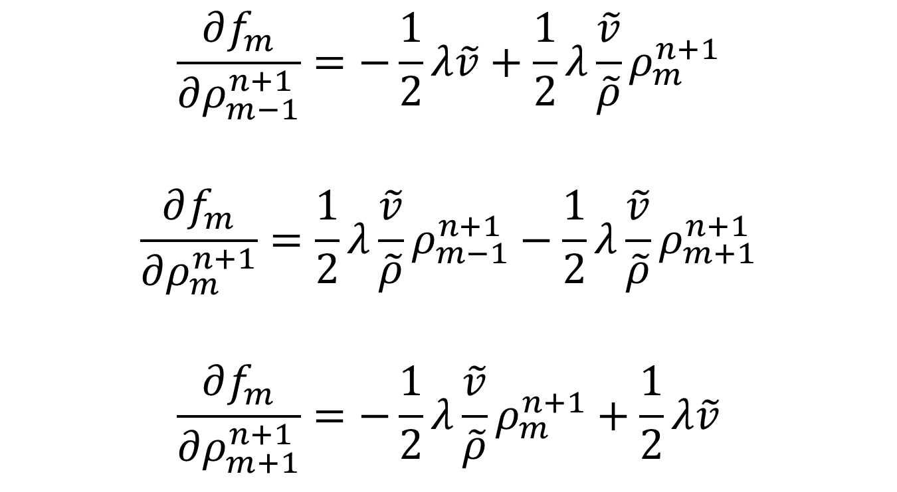
Lighthill-Whitham-Richards Model II
$$\frac{∂f_{m}}{∂ρ_{m−1}^{n+1}}=−\frac{1}{2}λ\tilde{v}+\frac{1}{2}λ\frac{\tilde{v}}{\tilde{ρ}}ρ_{m}^{n+1}$$
$$\frac{∂f_{m}}{∂ρ_{m}^{n+1}}=\frac{1}{2}λ\frac{\tilde{v}}{\tilde{ρ}}ρ_{m−1}^{n+1}−\frac{1}{2}λ\frac{\tilde{v}}{\tilde{ρ}}ρ_{m+1}^{n+1}$$
$$\frac{∂f_{m}}{∂ρ_{m+1}^{n+1}}=−\frac{1}{2}λ\frac{\tilde{v}}{\tilde{ρ}}ρ_{m}^{n+1}+\frac{1}{2}λ\tilde{v}$$

Slide 21
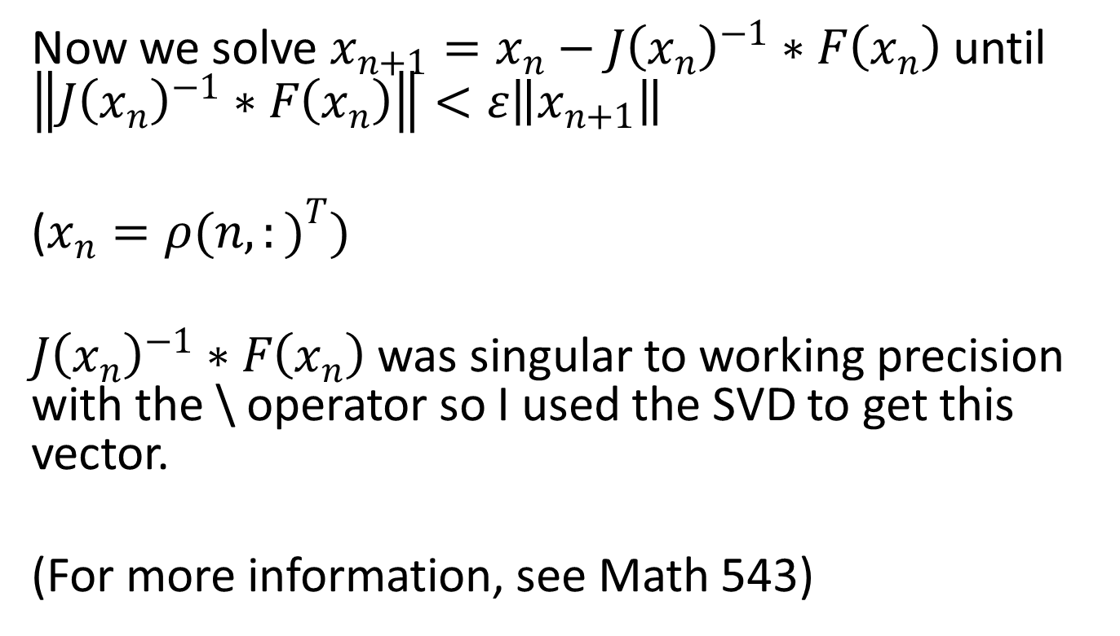
Lighthill-Whitham-Richards Model II
Now we solve $x_{n+1}=x_{n}−J{\left(x_{n}\right)}^{−1}∗F\left(x_{n}\right)$ until $\left\|J{\left(x_{n}\right)}^{−1}∗F\left(x_{n}\right)\right\|<ε\left\|x_{n+1}\right\|$
($x_{n}={ρ(n,:)}^{T})$
$J{\left(x_{n}\right)}^{−1}∗F\left(x_{n}\right)$ was singular to working precision with the \ operator so I used the SVD to get this vector.
(For more information, see Math 543)

Slide 22
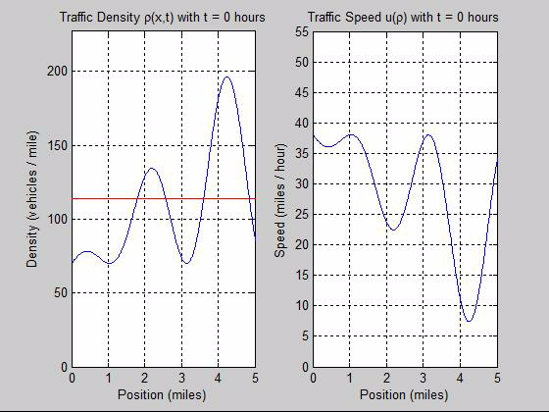
Lighthill-Whitham-Richards Model II

Slide 23
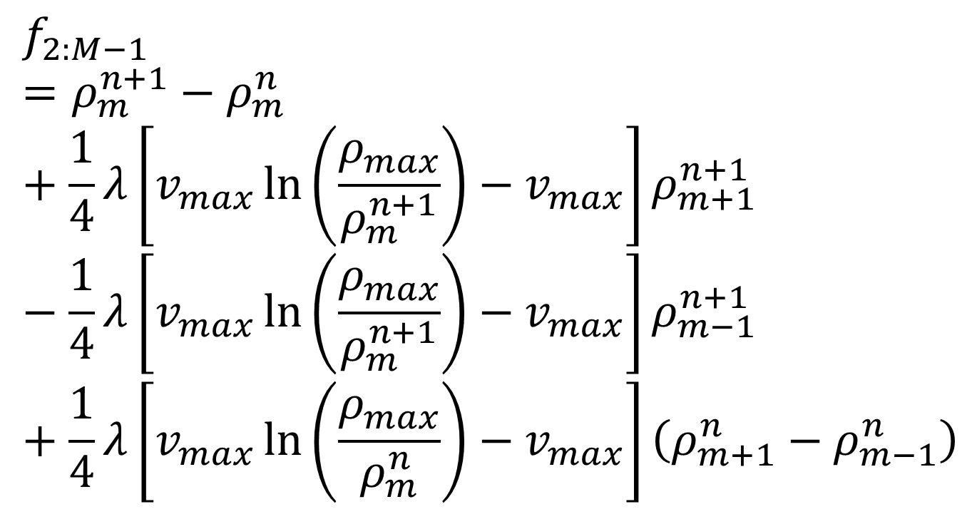
Greenberg Model II
$$f_{2:M−1}=ρ_{m}^{n+1}−ρ_{m}^{n}+\frac{1}{4}λ\left[v_{max}\ln\left(\frac{ρ_{max}}{ρ_{m}^{n+1}}\right)−v_{max}\right]ρ_{m+1}^{n+1}−\frac{1}{4}λ\left[v_{max}\ln\left(\frac{ρ_{max}}{ρ_{m}^{n+1}}\right)−v_{max}\right]ρ_{m−1}^{n+1}+\frac{1}{4}λ\left[v_{max}\ln\left(\frac{ρ_{max}}{ρ_{m}^{n}}\right)−v_{max}\right]\left(ρ_{m+1}^{n}−ρ_{m−1}^{n}\right)$$

Slide 24
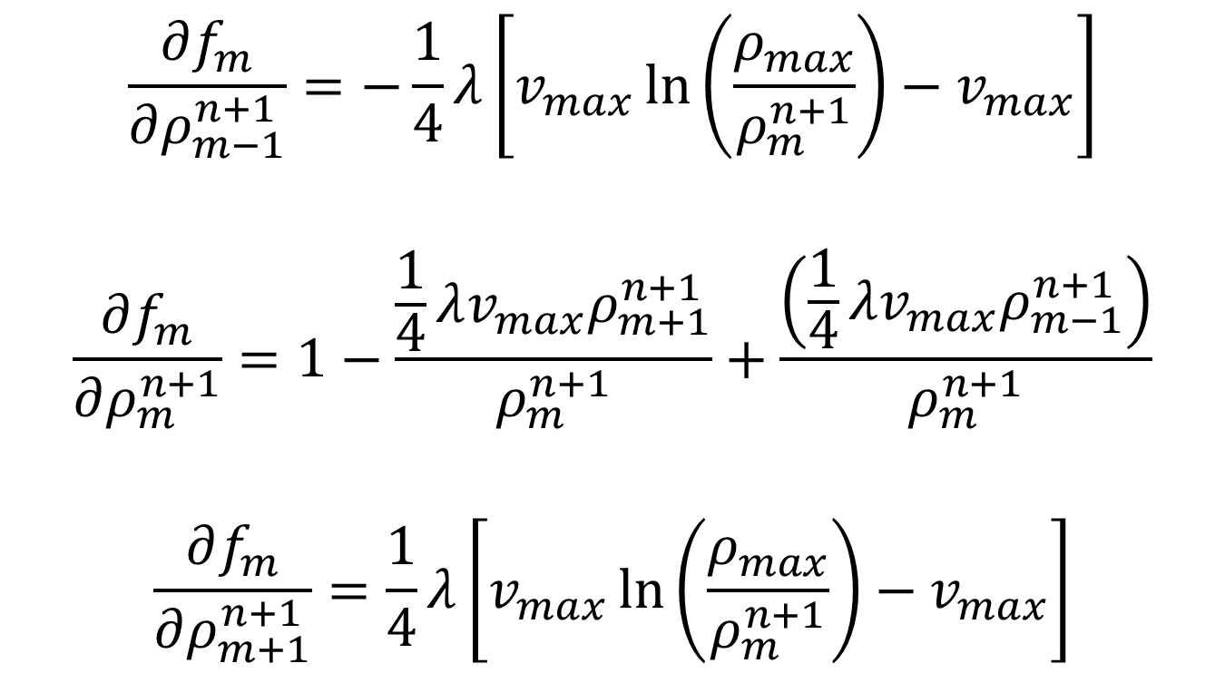
Greenberg Model II
$$\frac{∂f_{m}}{∂ρ_{m−1}^{n+1}}=−\frac{1}{4}λ\left[v_{max}\ln\left(\frac{ρ_{max}}{ρ_{m}^{n+1}}\right)−v_{max}\right]$$
$$\frac{∂f_{m}}{∂ρ_{m}^{n+1}}=1−\frac{\frac{1}{4}λv_{max}ρ_{m+1}^{n+1}}{ρ_{m}^{n+1}}+\frac{\left(\frac{1}{4}λv_{max}ρ_{m−1}^{n+1}\right)}{ρ_{m}^{n+1}}$$
$$\frac{∂f_{m}}{∂ρ_{m+1}^{n+1}}=\frac{1}{4}λ\left[v_{max}\ln\left(\frac{ρ_{max}}{ρ_{m}^{n+1}}\right)−v_{max}\right]$$

Slide 25
Greenberg Model II

Slide 26
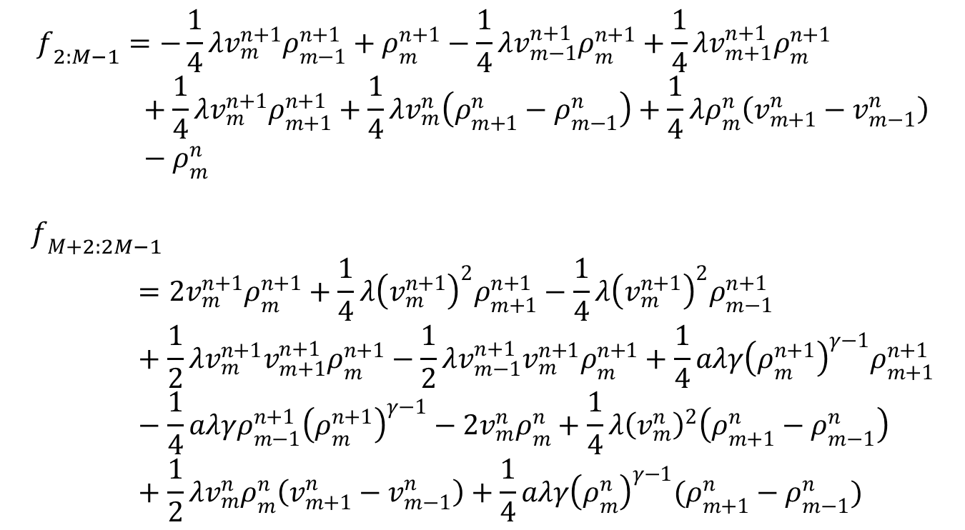
Payne-Whitham Model II
$$f_{2:M−1}=−\frac{1}{4}λv_{m}^{n+1}ρ_{m−1}^{n+1}+ρ_{m}^{n+1}−\frac{1}{4}λv_{m−1}^{n+1}ρ_{m}^{n+1}+\frac{1}{4}λv_{m+1}^{n+1}ρ_{m}^{n+1}+\frac{1}{4}λv_{m}^{n+1}ρ_{m+1}^{n+1}+\frac{1}{4}λv_{m}^{n}\left(ρ_{m+1}^{n}−ρ_{m−1}^{n}\right)+\frac{1}{4}λρ_{m}^{n}\left(v_{m+1}^{n}−v_{m−1}^{n}\right)−ρ_{m}^{n}$$
$$f_{M+2:2M−1}=2v_{m}^{n+1}ρ_{m}^{n+1}+\frac{1}{4}λ{\left(v_{m}^{n+1}\right)}^{2}ρ_{m+1}^{n+1}−\frac{1}{4}λ{\left(v_{m}^{n+1}\right)}^{2}ρ_{m−1}^{n+1}+\frac{1}{2}λv_{m}^{n+1}v_{m+1}^{n+1}ρ_{m}^{n+1}−\frac{1}{2}λv_{m−1}^{n+1}v_{m}^{n+1}ρ_{m}^{n+1}+\frac{1}{4}aλγ{\left(ρ_{m}^{n+1}\right)}^{γ−1}ρ_{m+1}^{n+1}−\frac{1}{4}aλγρ_{m−1}^{n+1}{\left(ρ_{m}^{n+1}\right)}^{γ−1}−2v_{m}^{n}ρ_{m}^{n}+\frac{1}{4}λ{\left(v_{m}^{n}\right)}^{2}\left(ρ_{m+1}^{n}−ρ_{m−1}^{n}\right)+\frac{1}{2}λv_{m}^{n}ρ_{m}^{n}\left(v_{m+1}^{n}−v_{m−1}^{n}\right)+\frac{1}{4}aλγ{\left(ρ_{m}^{n}\right)}^{γ−1}(ρ_{m+1}^{n}−ρ_{m−1}^{n})$$

Slide 27
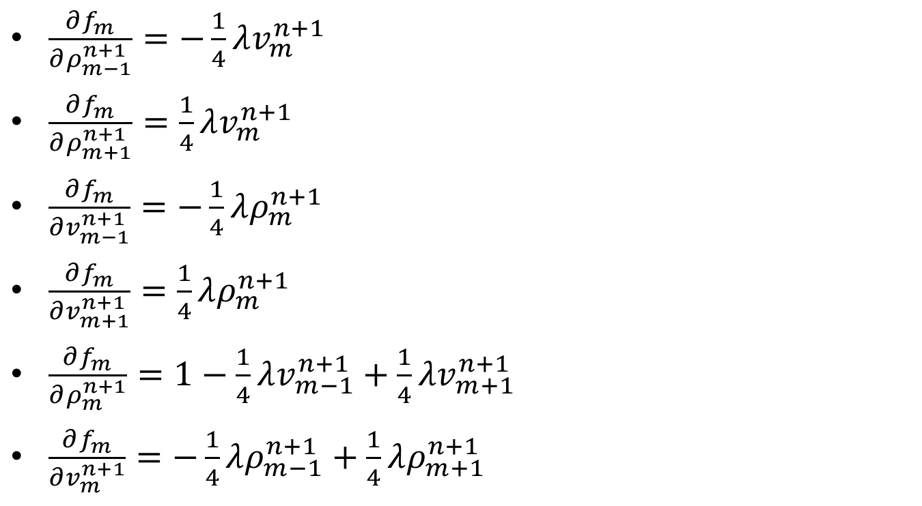
Payne-Whitham Model II
$\frac{∂f_{m}}{∂ρ_{m−1}^{n+1}}=−\frac{1}{4}λv_{m}^{n+1}$
$\frac{∂f_{m}}{∂ρ_{m+1}^{n+1}}=\frac{1}{4}λv_{m}^{n+1}$
$\frac{∂f_{m}}{∂v_{m−1}^{n+1}}=−\frac{1}{4}λρ_{m}^{n+1}$
$\frac{∂f_{m}}{∂v_{m+1}^{n+1}}=\frac{1}{4}λρ_{m}^{n+1}$
$\frac{∂f_{m}}{∂ρ_{m}^{n+1}}=1−\frac{1}{4}λv_{m−1}^{n+1}+\frac{1}{4}{λv}_{m+1}^{n+1}$
$\frac{∂f_{m}}{∂v_{m}^{n+1}}=−\frac{1}{4}λρ_{m−1}^{n+1}+\frac{1}{4}λρ_{m+1}^{n+1}$

Slide 28
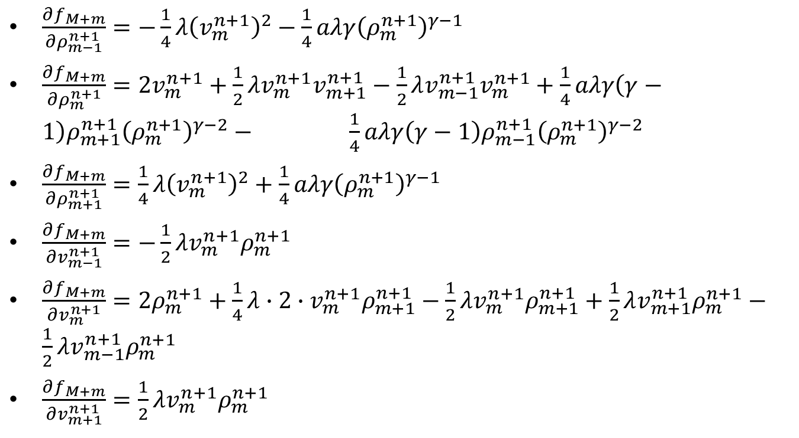
Payne-Whitham Model II
$\frac{∂f_{M+m}}{∂ρ_{m−1}^{n+1}}=−\frac{1}{4}λ{\left(v_{m}^{n+1}\right)}^{2}−\frac{1}{4}aλγ{\left(ρ_{m}^{n+1}\right)}^{γ−1}$
$\frac{∂f_{M+m}}{∂ρ_{m}^{n+1}}=2v_{m}^{n+1}+\frac{1}{2}λv_{m}^{n+1}v_{m+1}^{n+1}−\frac{1}{2}λv_{m−1}^{n+1}v_{m}^{n+1}+\frac{1}{4}aλγ\left(γ−1\right)ρ_{m+1}^{n+1}{\left(ρ_{m}^{n+1}\right)}^{γ−2}− \frac{1}{4}aλγ\left(γ−1\right)ρ_{m−1}^{n+1}{\left(ρ_{m}^{n+1}\right)}^{γ−2}$
$\frac{∂f_{M+m}}{∂ρ_{m+1}^{n+1}}=\frac{1}{4}λ{\left(v_{m}^{n+1}\right)}^{2}+\frac{1}{4}aλγ{\left(ρ_{m}^{n+1}\right)}^{γ−1}$
$\frac{∂f_{M+m}}{∂v_{m−1}^{n+1}}=−\frac{1}{2}λv_{m}^{n+1}ρ_{m}^{n+1}$
$\frac{∂f_{M+m}}{∂v_{m}^{n+1}}=2ρ_{m}^{n+1}+\frac{1}{4}λ∙2∙v_{m}^{n+1}ρ_{m+1}^{n+1}−\frac{1}{2}λv_{m}^{n+1}ρ_{m+1}^{n+1}+\frac{1}{2}λv_{m+1}^{n+1}ρ_{m}^{n+1}−\frac{1}{2}λv_{m−1}^{n+1}ρ_{m}^{n+1}$
$\frac{∂f_{M+m}}{∂v_{m+1}^{n+1}}=\frac{1}{2}λv_{m}^{n+1}ρ_{m}^{n+1}$

Slide 29

Payne-Whitham Model II
Side note: For this system of 2 equations, $x_{n}={[ρ\left(n,:\right),v\left(n,:\right)]}^{T}$

Slide 30
Payne-Whitham Model II

Slide 31
Now what’s wrong?
Another approach is to not use the chain rule and do a finite difference on the products of the functions instead

Slide 32
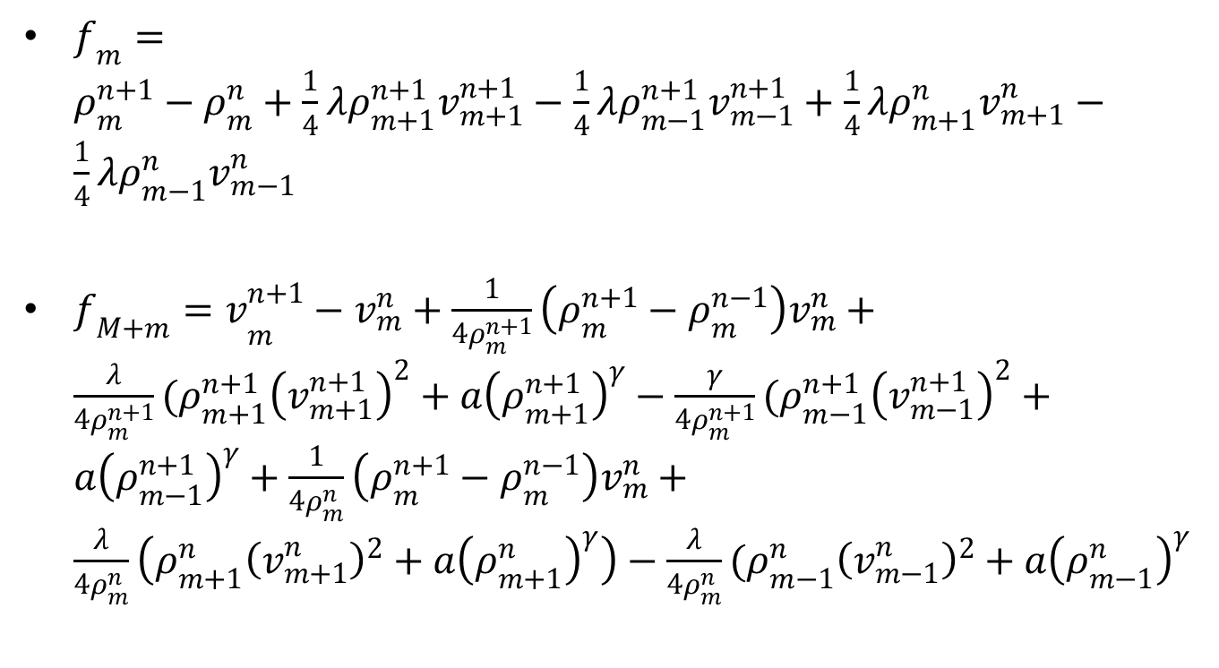
Payne-Whitham Model III
$f_{m}=ρ_{m}^{n+1}−ρ_{m}^{n}+\frac{1}{4}λρ_{m+1}^{n+1}v_{m+1}^{n+1}−\frac{1}{4}λρ_{m−1}^{n+1}v_{m−1}^{n+1}+\frac{1}{4}λρ_{m+1}^{n}v_{m+1}^{n}−\frac{1}{4}λρ_{m−1}^{n}v_{m−1}^{n}$
${f_{M+m}=v}_{m}^{n+1}−v_{m}^{n}+\frac{1}{4ρ_{m}^{n+1}}\left(ρ_{m}^{n+1}−ρ_{m}^{n−1}\right)v_{m}^{n}+\frac{λ}{4ρ_{m}^{n+1}}(ρ_{m+1}^{n+1}{\left(v_{m+1}^{n+1}\right)}^{2}+a{\left(ρ_{m+1}^{n+1}\right)}^{γ}−\frac{γ}{4ρ_{m}^{n+1}}(ρ_{m−1}^{n+1}{\left(v_{m−1}^{n+1}\right)}^{2}+a{\left(ρ_{m−1}^{n+1}\right)}^{γ}+\frac{1}{4ρ_{m}^{n}}\left(ρ_{m}^{n+1}−ρ_{m}^{n−1}\right)v_{m}^{n}+\frac{λ}{4ρ_{m}^{n}}\left(ρ_{m+1}^{n}{\left(v_{m+1}^{n}\right)}^{2}+a{\left(ρ_{m+1}^{n}\right)}^{γ}\right)−\frac{λ}{4ρ_{m}^{n}}(ρ_{m−1}^{n}{\left(v_{m−1}^{n}\right)}^{2}+a{\left(ρ_{m−1}^{n}\right)}^{γ}$

Slide 33

Payne-Whitham Model III
$\frac{∂f_{m}}{∂ρ_{m−1}^{n+1}}=−\frac{1}{4}λv_{m−1}^{n+1}$
$\frac{∂f_{m}}{∂ρ_{m}^{n+1}}=1$
$\frac{∂f_{m}}{∂ρ_{m+1}^{n+1}}=\frac{1}{4}λv_{m+1}^{n+1}$
$\frac{∂f_{m}}{∂v_{m−1}^{n+1}}=−\frac{1}{4}λρ_{m−1}^{n+1}$
$\frac{∂f_{m}}{∂v_{m}^{n+1}}=0$
$\frac{∂f_{m}}{∂v_{m+1}^{n+1}}=\frac{1}{4}λρ_{m+1}^{n+1}$

Slide 34
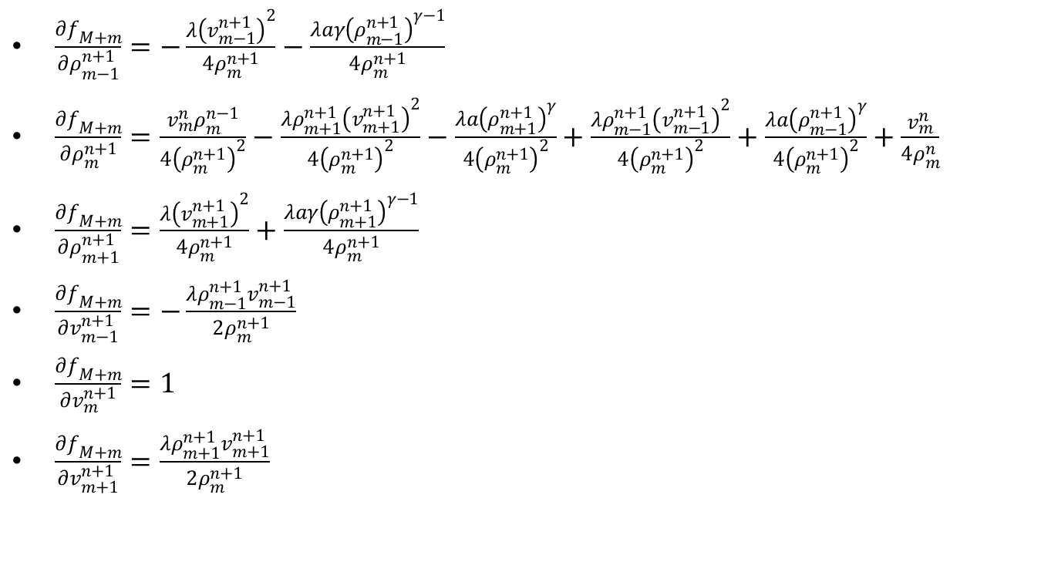
Payne-Whitham Model III
$\frac{∂f_{M+m}}{∂ρ_{m−1}^{n+1}}=−\frac{λ{\left(v_{m−1}^{n+1}\right)}^{2}}{4ρ_{m}^{n+1}}−\frac{λaγ{\left(ρ_{m−1}^{n+1}\right)}^{γ−1}}{4ρ_{m}^{n+1}}$
$\frac{∂f_{M+m}}{∂ρ_{m}^{n+1}}=\frac{v_{m}^{n}ρ_{m}^{n−1}}{4{\left(ρ_{m}^{n+1}\right)}^{2}}−\frac{λρ_{m+1}^{n+1}{\left(v_{m+1}^{n+1}\right)}^{2}}{4{\left(ρ_{m}^{n+1}\right)}^{2}}−\frac{λa{\left(ρ_{m+1}^{n+1}\right)}^{γ}}{4{\left(ρ_{m}^{n+1}\right)}^{2}}+\frac{λρ_{m−1}^{n+1}{\left(v_{m−1}^{n+1}\right)}^{2}}{4{\left(ρ_{m}^{n+1}\right)}^{2}}+\frac{λa{\left(ρ_{m−1}^{n+1}\right)}^{γ}}{4{\left(ρ_{m}^{n+1}\right)}^{2}}+\frac{v_{m}^{n}}{4ρ_{m}^{n}}$
$\frac{∂f_{M+m}}{∂ρ_{m+1}^{n+1}}=\frac{λ{\left(v_{m+1}^{n+1}\right)}^{2}}{4ρ_{m}^{n+1}}+\frac{λaγ{\left(ρ_{m+1}^{n+1}\right)}^{γ−1}}{4ρ_{m}^{n+1}}$
$\frac{∂f_{M+m}}{∂v_{m−1}^{n+1}}=−\frac{λρ_{m−1}^{n+1}v_{m−1}^{n+1}}{2ρ_{m}^{n+1}}$
$\frac{∂f_{M+m}}{∂v_{m}^{n+1}}=1$
$\frac{∂f_{M+m}}{∂v_{m+1}^{n+1}}=\frac{λρ_{m+1}^{n+1}v_{m+1}^{n+1}}{2ρ_{m}^{n+1}}$

Slide 35
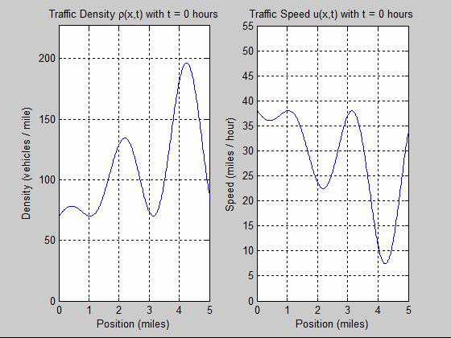
Payne-Whitham Model III

Slide 36
Example Code for Payne-Whitham Model III
h = 1/60; % delta x (mi)
k = 1/1000; % delta t
lambda = k/h;
X = -1:h:6; % Grid in position
T = 0:k:.02; % Grid in time
N = numel(T);
M = numel(X);
v = zeros(N, M); % Traffic Speed
p = zeros(N, M); % Traffic Density
Vmax = 55; % mi/hr - Driver's desired speed on empty road
RHOmax = 227; % veh/mi - this may have to be multipled by h.
a = 1;
gamma = 2;
F = zeros(2*M,1);
J = zeros(2*M);
x = zeros(2*M,1);
epsilon = 1e-6;

Slide 37
Example Code for Payne-Whitham Model III
% This is to compute the 2nd time step:
n = 1;
% Initial guess for p(n+1,:) and v(n+1,:)
x(1:M) = p(n,:);
x(M+1:2*M) = v(n,:);
dx = 1 + norm(x);
error = epsilon * norm(x);
iteration = 0;
while norm(dx) > error
p(n+1,:) = x(1:M);
v(n+1,:) = x(M+1:2*M);

Slide 38
Example Code for Payne-Whitham Model III
% Build the function vector
F(1) = p(n,1); % Some boundary condition maybe w(n,1)
for m = 2:M-1
F(m) = -1/4*lambda*v(n+1,m)*p(n+1,m-1) + p(n+1,m) - 1/4*lambda*v(n+1,m-1)*p(n+1,m) ...
+ 1/4*lambda*v(n+1,m+1)*p(n+1,m) + 1/4*lambda*v(n+1,m)*p(n+1,m+1) ...
+ 1/4*lambda*v(n,m)*(p(n,m+1)-p(n,m-1)) ...
+ 1/4*lambda*p(n,m)*(v(n,m+1)-v(n,m-1));
end
F(M) = p(n,M);
F(M+1) = v(n,1);
for m = 2:M-1
F(M+m) = 2*v(n+1,m)*p(n+1,m) + 1/4*lambda*v(n+1,m)^2*p(n+1,m+1) ...
- 1/4*lambda*v(n+1,m)^2*p(n+1,m-1) + 1/2*lambda*v(n+1,m)*v(n+1,m+1)*p(n+1,m) ...
- 1/2*lambda*v(n+1,m)*v(n+1,m-1)*p(n+1,m) ...
+ 1/4*a*lambda*gamma*p(n+1,m)^(gamma-1)*p(n+1,m+1) ...
- 1/4*a*lambda*gamma*p(n+1,m)^(gamma-1)*p(n+1,m-1) ...
- 2*v(n,m)*p(n,m) + 1/4*lambda*v(n,m)^2*(p(n,m+1)-p(n,m-1))...
+ 1/2*lambda*v(n,m)*p(n,m)*(v(n,m+1)-v(n,m+1))...
+ 1/4*a*lambda*gamma*p(n,m)^(gamma-1)*(p(n,m+1)-p(n,m-1));
end
F(2*M) = v(n,M);

Slide 39
Example Code for Payne-Whitham Model III
% Build the Jacobian
for m = 2:M-1
J(m,m-1) = -1/4*lambda*v(n+1,m);
J(m,m) = 1 - 1/4*lambda*v(n+1,m-1) + 1/4*lambda*v(n+1,m+1);
J(m,m+1) = 1/4*lambda*v(n+1,m);
J(m,M+m-1) = -1/4*lambda*p(n+1,m);
J(m,M+m) = 1/4*lambda*p(n+1,m+1) - 1/4*lambda*p(n+1,m-1);
J(m,M+m+1) = 1/4*lambda*p(n+1,m);
J(M+m,m-1) = -1/4*lambda*v(n+1,m)^2 - 1/4*lambda*a*gamma*p(n+1,m)^(gamma-1);
J(M+m,m) = 2*v(n+1,m) + 1/2*lambda*v(n+1,m)*v(n+1,m+1) - 1/2*lambda*v(n+1,m)*v(n+1,m-1) + 1/4*lambda*a*gamma*(gamma-1)*p(n+1,m+1)*p(n+1,m)^(gamma-2) - 1/4*lambda*a*gamma*(gamma-1)*p(n+1,m-1)*p(n+1,m)^(gamma-2);
J(M+m,m+1) = 1/4*lambda*v(n+1,m)^2 + 1/4*lambda*a*gamma*p(n+1,m)^(gamma-1);
J(M+m,M+m-1) = -1/2*lambda*v(n+1,m)*p(n+1,m);
J(M+m,M+m) = 2*p(n+1,m) + 1/2*lambda*v(n+1,m)*p(n+1,m+1) - 1/2*lambda*v(n+1,m)*p(n+1,m-1) + 1/2*lambda*v(n+1,m+1)*p(n+1,m) - 1/2*lambda*v(n+1,m-1)*p(n+1,m);
J(M+m,M+m+1) = 1/2*lambda*v(n+1,m)*p(n+1,m);
end

Slide 40
Example Code for Payne-Whitham Model III
dx = solveSVD(J,F);
x = x - dx;
error = epsilon * norm(x);
iteration = iteration + 1;
if iteration == 10
disp('Maximum iterations exceeded')
break
end

Slide 41
Example Code for Payne-Whitham Model III
p(n+1,:) = x(1:M);
v(n+1,:) = x(M+1:2*M);
disp('Computed n = 2')
% Rezero x, J, and F for the next time steps
F = zeros(2*M,1);
J = zeros(2*M);
x = zeros(2*M,1);

Slide 42
Example Code for Payne-Whitham Model III
for n = 2:N-1
disp([num2str(n/N*100), '% done'])
% Initial guess for p(n+1,:) and v(n+1,:)
x(1:M) = p(n,:);
x(M+1:2*M) = v(n,:);
dx = 1 + norm(x);
error = epsilon * norm(x);
iteration = 0;
while norm(dx) > error
p(n+1,:) = x(1:M);
v(n+1,:) = x(M+1:2*M);

Slide 43
Example Code for Payne-Whitham Model III
% Build the function vector
F(1) = p(n,1); % Some boundary condition maybe w(n,1)
for m = 2:M-1
F(m) = p(n+1,m) - p(n,m) ...
+ 1/4*lambda*(p(n+1,m+1)*v(n+1,m+1) - p(n+1,m-1)*v(n+1,m-1))...
+ 1/4*lambda*(p(n,m+1)*v(n,m+1) - p(n,m-1)*v(n,m-1));
end
F(M) = p(n,M); % Some boundary condition... probably w(n,M)
F(M+1) = v(n,1); % Some boundary condition maybe v(n,1)
for m = 2:M-1
F(M+m) = v(n+1,m) - v(n,m) ...
+ v(n,m)/(4*p(n+1,m))*(p(n+1,m) - p(n-1,m))...
+ lambda/(4*p(n+1,m))*(p(n+1,m+1)*v(n+1,m+1)^2 + a*p(n+1,m+1)^gamma) ...
- lambda/(4*p(n+1,m))*(p(n+1,m-1)*v(n+1,m-1)^2 + a*p(n+1,m-1)^gamma) ...
+ v(n,m)/(4*p(n,m))*(p(n+1,m) - p(n-1,m))...
+ lambda/(4*p(n,m))*(p(n,m+1)*v(n,m+1)^2 + a*p(n,m+1)^gamma) ...
- lambda/(4*p(n,m))*(p(n,m-1)*v(n,m-1)^2 + a*p(n,m-1)^gamma);
end
F(2*M) = v(n,M);

Slide 44
Example Code for Payne-Whitham Model III
% Build the Jacobian
for m = 2:M-1
J(m,m-1) = -1/4*lambda*v(n+1,m-1);
J(m,m) = 1;
J(m,m+1) = 1/4*lambda*v(n+1,m+1);
J(m,M+m-1) = -1/4*lambda*p(n+1,m-1);
J(m,M+m) = 0;
J(m,M+m+1) = 1/4*lambda*p(n+1,m+1);
J(M+m,m-1) = -lambda/(4*p(n+1,m)) * (v(n+1,m-1)^2 ...
+ a*gamma*p(n+1,m-1)^(gamma-1));
J(M+m,m) = (v(n,m)*p(n-1,m))/(4*p(n+1,m)^2) ...
+ lambda/(4*p(n+1,m)^2) * (-p(n+1,m+1)*v(n+1,m+1)^2 ...
- a*p(n+1,m+1)^gamma + p(n+1,m-1)*v(n+1,m-1)^2 ...
+ a*p(n+1,m-1)^gamma ) + v(n,m)/(4*p(n,m));
J(M+m,m+1) = lambda/(4*p(n+1,m)) * (v(n+1,m+1)^2 ...
+ a*gamma*p(n+1,m+1)^(gamma-1));
J(M+m,M+m-1) = -lambda*p(n+1,m-1)*v(n+1,m-1)/(2*p(n+1,m));
J(M+m,M+m) = 1;
J(M+m,M+m+1) = lambda*p(n+1,m-1)*v(n+1,m-1)/(2*p(n+1,m));
end

Slide 45
Example Code for Payne-Whitham Model III
% Newton's Method
dx = solveSVD(J,F);
x = x - dx;
error = epsilon * norm(x);
iteration = iteration + 1;
if iteration == 30
disp('Maximum iterations exceeded')
break
end
end
end

Slide 46
Boundary Conditions
Nonlinear equations have hard boundary conditions – It’s easier to solve the equation for a larger grid and only show the solution for the smaller section
Large Boundary
Solution Space

Slide 47
Questions?
Josh Hallam

