Slide 1
Pendulum Waves
Josh Hallam
Travis Meindl

Slide 2



Equations
where

Slide 3
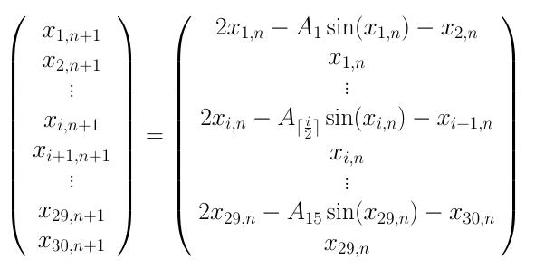
Equations

Slide 4
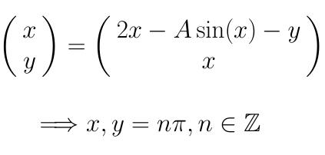
Fixed points

Slide 5

Stability
Local Linearization

Slide 6
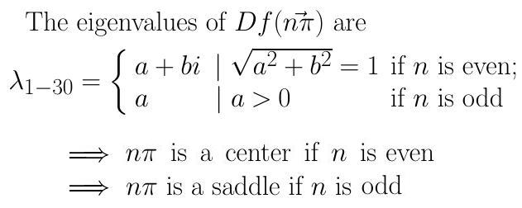
Stability

Slide 7
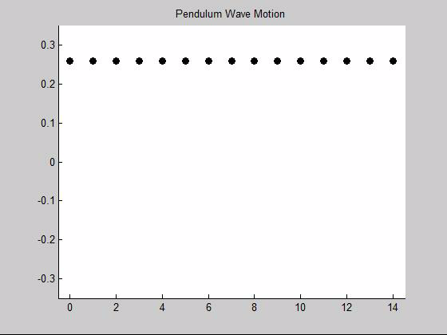

Slide 8
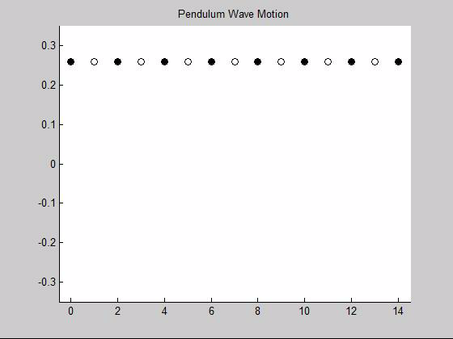

Slide 9
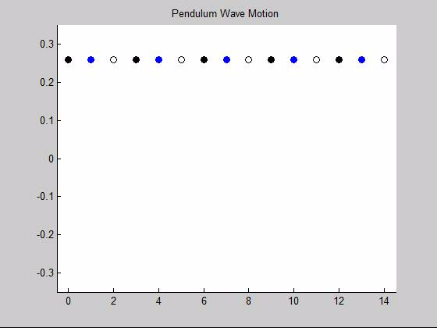

Slide 10
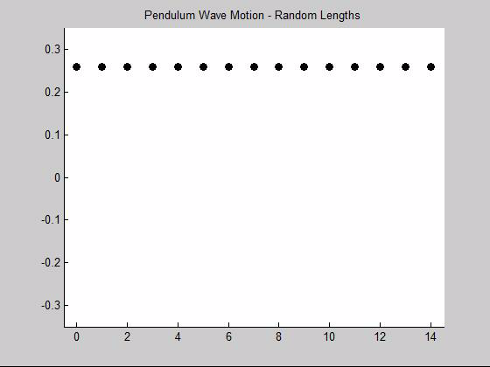
Changing the parameter A

