Slide 1
Numerical Calculations of Lyapunov Numbers
Josh Hallam

Slide 2
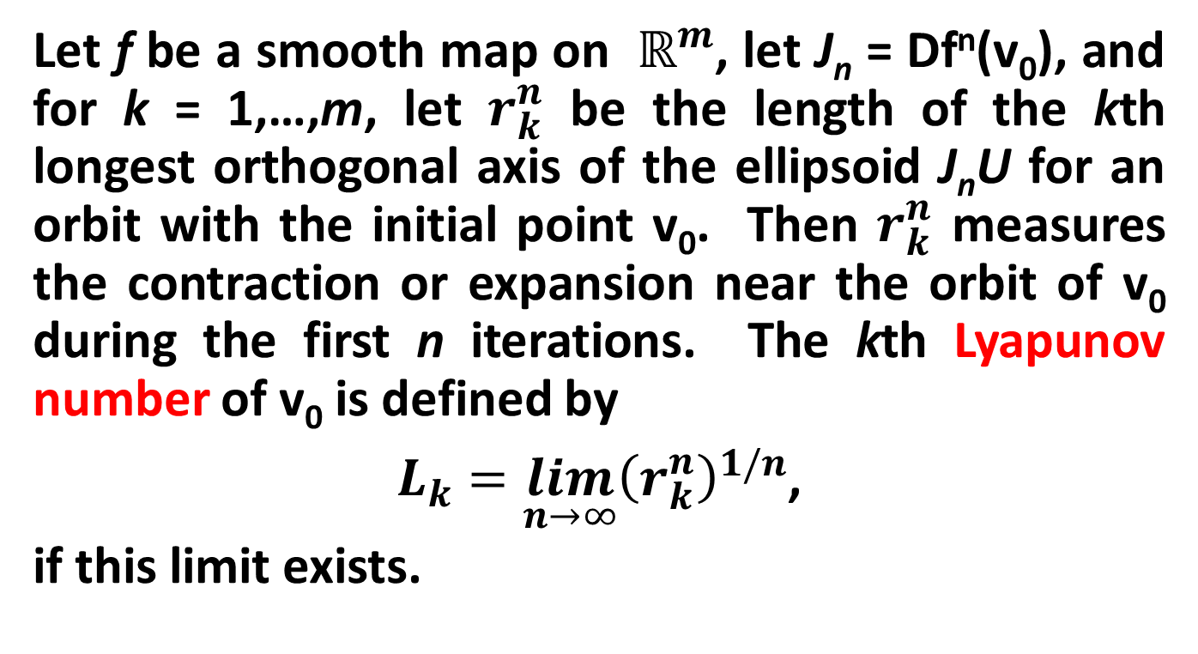
Definititions
Let f be a smooth map on $ℝ^{m}$, let J_{n} = Df^{n}(v₀), and for k = 1,…,m, let $r_{k}^{n}$ be the length of the kth longest orthogonal axis of the ellipsoid J_{n}U for an orbit with the initial point v₀. Then $r_{k}^{n}$ measures the contraction or expansion near the orbit of v₀ during the first n iterations. The kth Lyapunov number of v₀ is defined by
$L_{k}=\lim_{n→∞}{{\left(r_{k}^{n}\right)}^{1/n}}$,
if this limit exists.

Slide 3
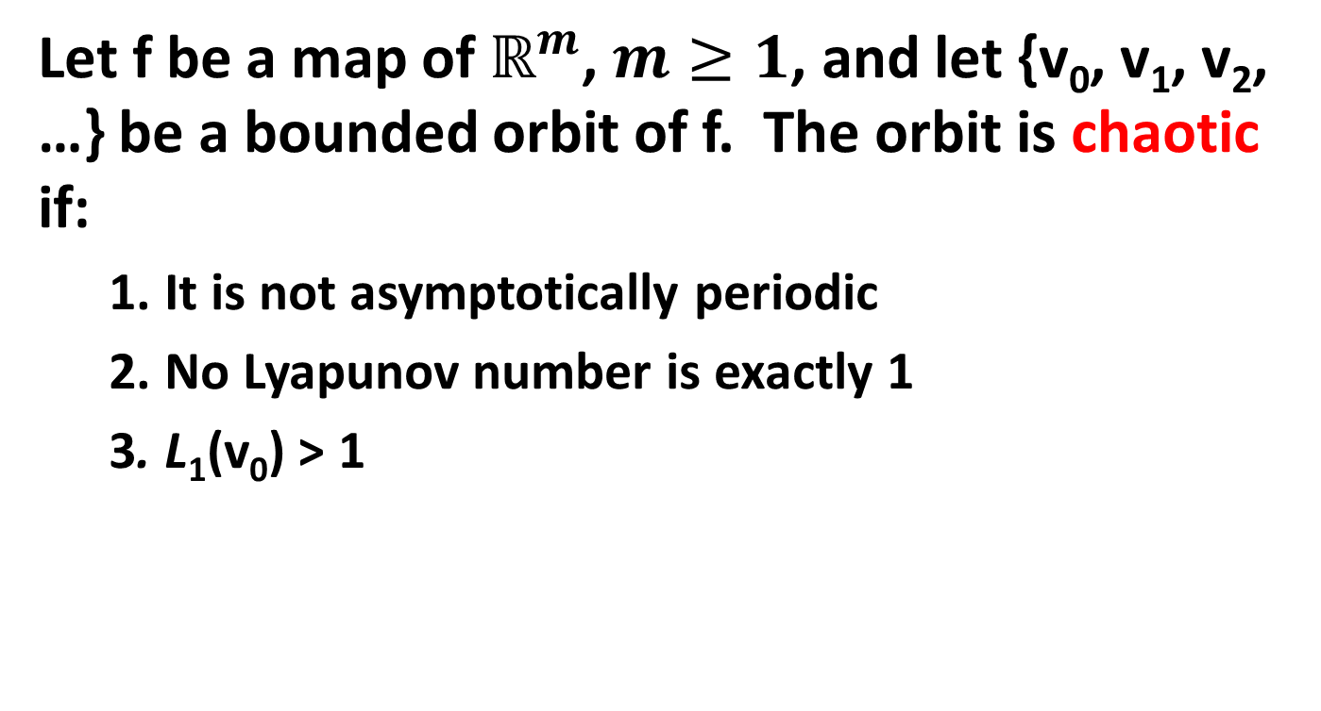
Definitions
Let f be a map of $ℝ^{m}$, $m≥1$, and let {v₀, v₁, v₂, …} be a bounded orbit of f. The orbit is chaotic if:
  1. It is not asymptotically periodic
  2. No Lyapunov number is exactly 1
  3. L₁(v₀) > 1

Slide 4
The Code
function [ L, h ] = lyapunov( A, a, v0, N )
[m, n] = size(A);
h = zeros(m,1);
L = zeros(m,1);
w = zeros(m,m,N+1);
z = zeros(m,m);
y = zeros(m,m,N);
v = zeros(m,1,N+1);
sum = zeros(m,1);
J = jacobian(A,a);
Afunc = matlabFunction(A); % convert A to a function
Jfunc = matlabFunction(J,'vars',a); % convert J to a function
v(:,1,1) = v0;
w(:,:,1) = eye(m);

Slide 5
The Code
for j = 1:N
for i = 1:m
tmp_ = num2cell( v(:,1,j) );
z(:,i) = Jfunc(tmp_{:})*w(:,i,j);
end
for i = 1:m
% Do Gram-Schmidt orthogonalization on z
y(:,i,j) = z(:,i);
for k = 1:i-1
y(:,i,j) = y(:,i,j) - ...
(dot(z(:,i), y(:,k,j)) / norm(y(:,k,j))^2) * y(:,k,j);
end
w(:,i,j+1) = y(:,i,j)/ norm(y(:,i,j)); % Normalize vector to eliminate
% very large and very small
% numbers
end
tmp_ = num2cell( v(:,1,j) );
v(:,1,j+1) = Afunc( tmp_{:} );
end

Slide 6
The Code
for i = 1:m
for j = 1:N
sum(i) = sum(i) + log(norm(y(:,i,j)));
end
h(i) = sum(i)/(N);
L(i) = exp(h(i));
end
h = sort(h,'descend');
L = sort(L,'descend');
end

Slide 7

1D - The Logistic Map
$$x_{n+1}=λx_{n}\left(1−x_{n}\right)$$
syms x;
v0 = .45;
K = 100000;
for r = [2, 3, 4]
A = r*x*(1-x);
[L, h] = lyapunov(A,x,v0,K)
end

Slide 8
1D - The Logistic Map
When λ = 2, L = 0

Slide 9
1D - The Logistic Map
When λ = 3, L = 0.999846

Slide 10
1D - The Logistic Map
When λ = 4, L = 1.99997

Slide 11
1D – The Logistic Map

Slide 12
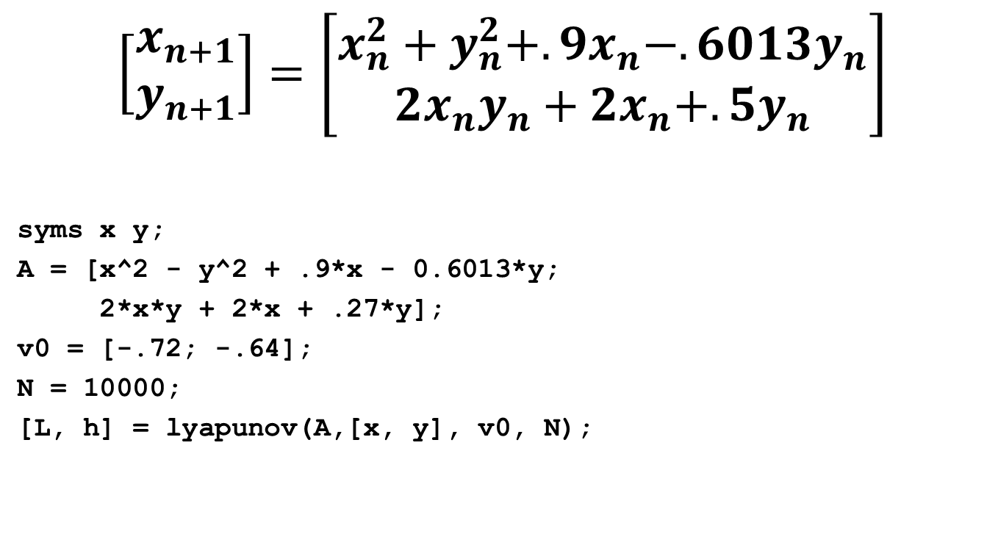
2D – The Tinkerbell Map
$$\left[\begin{matrix}x_{n+1} \\ y_{n+1}\end{matrix}\right]=\left[\begin{matrix}x_{n}^{2}+y_{n}^{2}+.9x_{n}−.6013y_{n} \\ 2x_{n}y_{n}+2x_{n}+.5y_{n}\end{matrix}\right]$$
syms x y;
A = [x^2 - y^2 + .9*x - 0.6013*y;
2*x*y + 2*x + .27*y];
v0 = [-.72; -.64];
N = 10000;
[L, h] = lyapunov(A,[x, y], v0, N);

Slide 13
2D – The Tinkerbell Map
L₁ = 1.0259, L₂ = 0.8322

Slide 14

3D – Generalized Lotka-Volterra Map
$$\left[\begin{matrix}x_{n+1} \\ y_{n+1} \\ z_{n+1}\end{matrix}\right]=\left[\begin{matrix}x_{n}\left(2−x_{n}+.675y_{n}−.5z_{n}\right) \\ y_{n}\left(2−.5x_{n}−y_{n}+.675z_{n}\right) \\ z_{n}\left(2+.675x_{n}−.5y_{n}−z_{n}\right)\end{matrix}\right]$$

Slide 15
3D – Generalized Lotka-Volterra Map
syms x y z
a = [-1, .675, -.5;
-.5, -1, .675;
.675, -.5, -1];
e = [2; 2; 2];
T = [x*(e(1)+a(1,1)*x+a(1,2)*y+a(1,3)*z);
y*(e(2)+a(2,1)*x+a(2,2)*y+a(2,3)*z);
z*(e(3)+a(3,1)*x+a(3,2)*y+a(3,3)*z)];
v0 = [.25; .33; .12];
K = 100000;
[L, h] = lyapunov(T,[x, y, z], v0, K);

Slide 16
3D – Generalized Lotka-Volterra Map
L₁ = 1.0767 L₂ = 0.9778 L₃ = 0.3568
x-y plane:
x-z plane:
y-z plane:

Slide 17
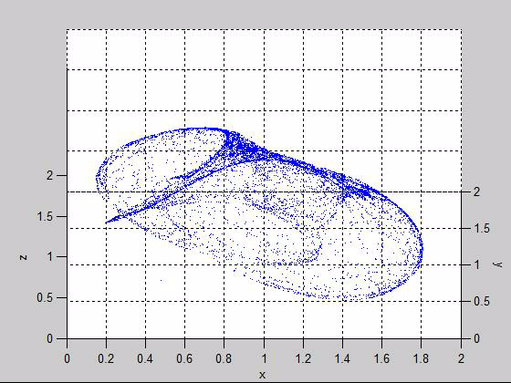
3D – Generalized Lotka-Volterra Map

Slide 18
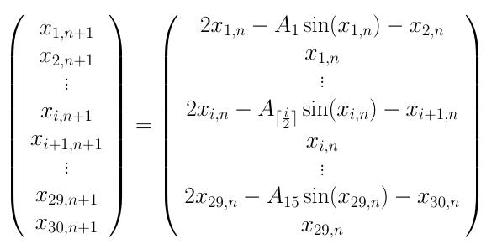
30D – Pendulum Waves

Slide 19
30D – Pendulum Waves
syms x1 x2 x3 x4 x5 x6 x7 x8 x9 x10 x11 x12 x13 x14 x15 x16 x17 x18 x19 x20 x21 x22 x23 x24 x25 x26 x27 x28 x29 x30;
l = [1 0.927297668 0.862244898 0.803804994 0.751111111 ...
0.703433923 0.66015625 0.620752984 0.584775087 0.551836735 ...
0.521604938 0.493791088 0.468144044 0.444444444 0.4225];
g = 9.8;
K = l ./ g;
A = [2*x1 - K(1)*sin(x1)-x2; x1;
2*x3 - K(2)*sin(x3)-x4; x3;
2*x5 - K(3)*sin(x5)-x6; x5;
2*x7 - K(4)*sin(x7)-x8; x7;
2*x9 - K(5)*sin(x9)-x10; x9;
2*x11 - K(6)*sin(x11)-x12; x11;
2*x13 - K(7)*sin(x13)-x14; x13;
2*x15 - K(8)*sin(x15)-x16; x15;
2*x17 - K(9)*sin(x17)-x18; x17;
2*x19 - K(10)*sin(x19)-x20; x19;
2*x21 - K(11)*sin(x21)-x22; x21;
2*x23 - K(12)*sin(x23)-x24; x23;
2*x25 - K(13)*sin(x25)-x26; x25;
2*x27 - K(14)*sin(x27)-x28; x27;
2*x29 - K(15)*sin(x29)-x30; x29;];
v0 = [0.261799387799149; 0.249217380574659;
0.282868266206791; 0.268244419963807;
0.304869644392350; 0.287965847978721;
0.327833145080897; 0.308393591940727;
0.351793019525310; 0.329543572650138;
0.376788915819065; 0.351436463355374;
0.402866816988009; 0.374098615009582;
0.430080198368775; 0.397563196520627;
0.458491471361727; 0.421871616155080;
0.488173815687707; 0.447075323674904;
0.519213517345463; 0.473238110799627;
0.551713020829129; 0.500439113607177;
0.585794970513747; 0.528776789105100;
0.621607663828993; 0.558374283923831;
0.659332576233307; 0.589386847571669];
a = [x1, x2, x3, x4, x5, x6, x7, x8, x9, x10, x11, x12, x13, x14, x15, ...
x16, x17, x18, x19, x20, x21, x22, x23, x24, x25, x26, x27, x28, ...
x29, x30];
N = 10000;
[L, h] = lyapunov(A, a, v0, N);

Slide 20
30D – Pendulum Waves
Number Exponent
Number Exponent
1.0006 0.0006
1.0006 0.0006
1.0005 0.0005
1.0005 0.0005
1.0005 0.0005
1.0005 0.0005
1.0005 0.0005
1.0004 0.0004
1.0004 0.0004
1.0004 0.0004
1.0003 0.0003
1.0003 0.0003
1.0003 0.0003
1.0003 0.0003
1.0002 0.0002
0.9998 -0.0002
0.9997 -0.0003
0.9997 -0.0003
0.9997 -0.0003
0.9997 -0.0003
0.9996 -0.0004
0.9996 -0.0004
0.9996 -0.0004
0.9995 -0.0005
0.9995 -0.0005
0.9995 -0.0005
0.9995 -0.0005
0.9995 -0.0005
0.9994 -0.0006
0.9994 -0.0006

Slide 21
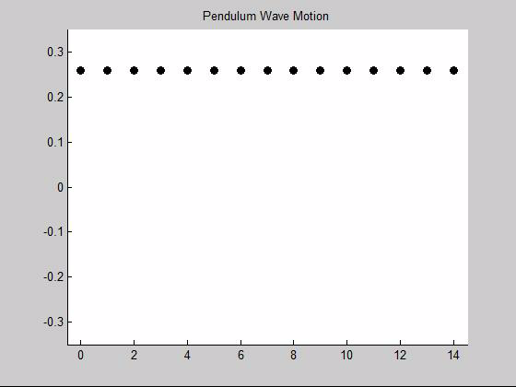
30D – Pendulum Waves

Slide 22
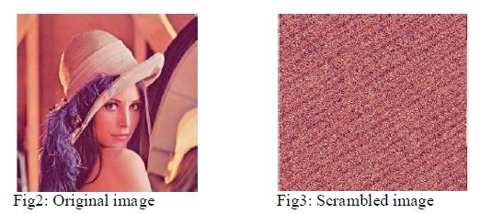
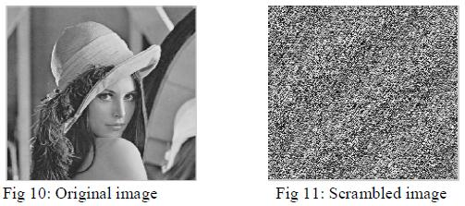
2D-map Encryption

Slide 23
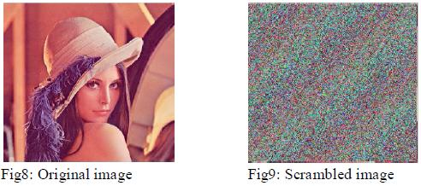
3D-map encryption

Slide 24
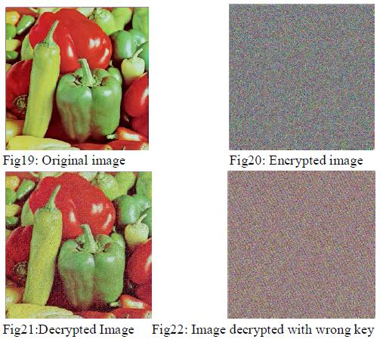

$ε$ away from correct key
Source: 3D Chaotic Functions for Image Encryption by Khade and Narnaware

Slide 25
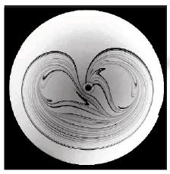
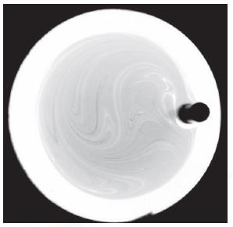
Mixing Fluids
Non-Chaotic Mixing
Chaotic Mixing
Source: Chaotic mixing of viscous fluids by Gouillart, Dauchot, and Thiffeault

Slide 26
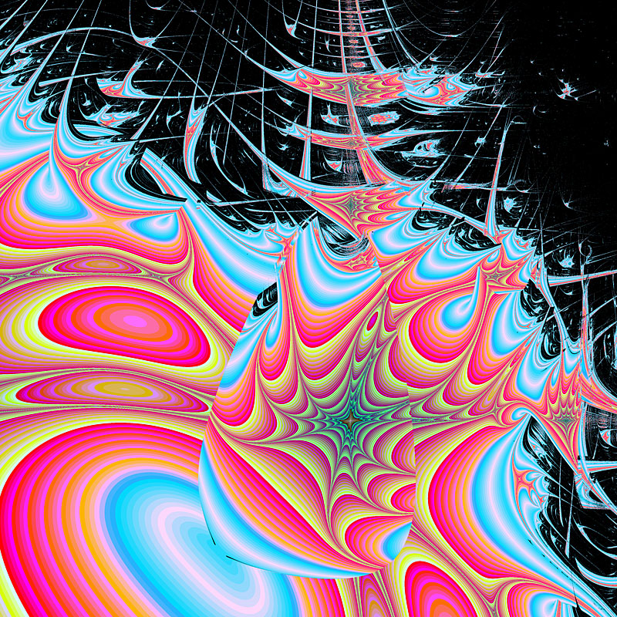
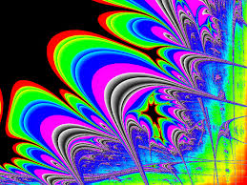
Lyapunov Fractals
Source: Paul Brown - http://www.arttech.ab.ca/pbrown/tws_fractals/fractal_images.html

Slide 27
Questions?

