Slide 1
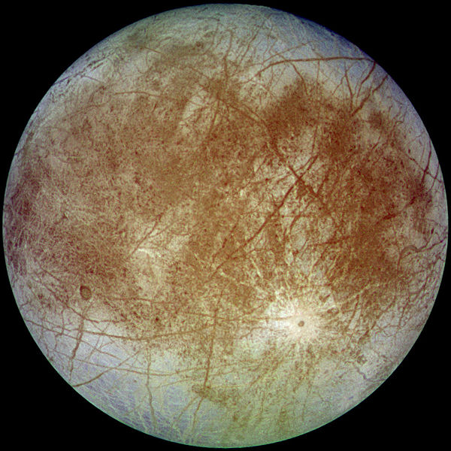
Two Point Boundary Value Problem
Josh Hallam

Slide 2
Why Europa?
According to astronomers, Europa is the most likely place in our solar system to harbor life.
They believe it has vast oceans of liquid water underneath an ice shell that can support life similar to terrestrial life.

Slide 3
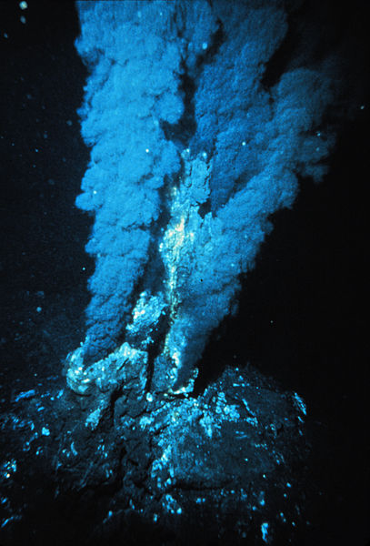
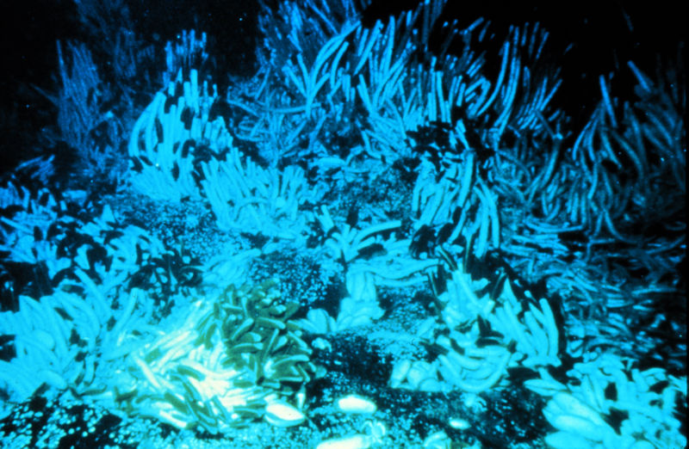

Chemosynthetic Based Life
Tube Worms
Hydrothermal Vents

Slide 4
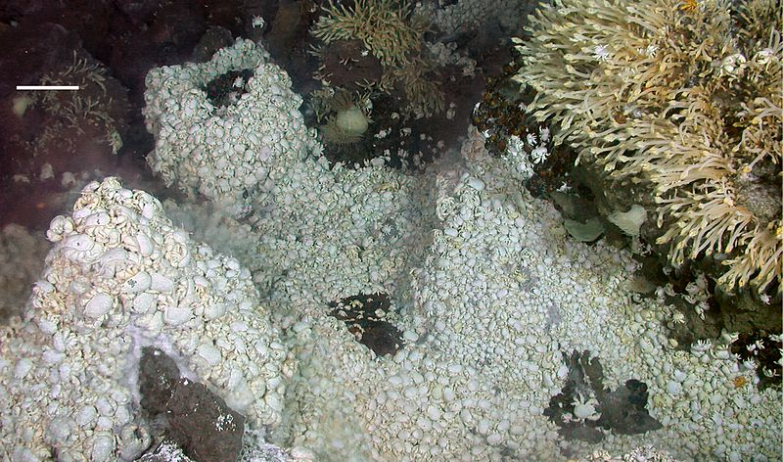
Chemosynthetic Based Life
Kiwa Colony on Blacksmoker vent

Slide 5
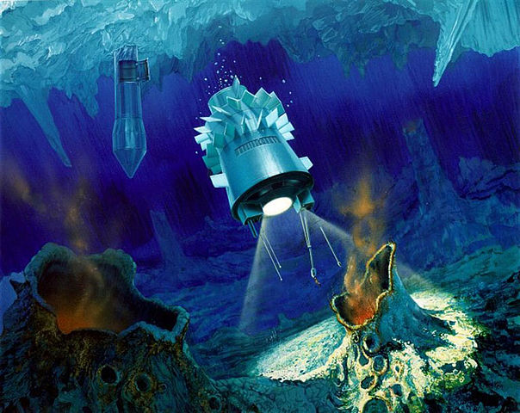
Robotic Submarine Mission

Slide 6
The Method
Nonlinear shooting method
  Start with initial and final positions, and guess an initial velocity to reach the final position.
  Update the velocity at each iteration to get the real final position closer to the desired final position.

Slide 7
The Problems
Initial conditions
Final conditions
5/6 body problem
Step size
Duration of flight
Newton’s Method update
Stopping Conditions
Convergence
Existence of solution

Slide 8
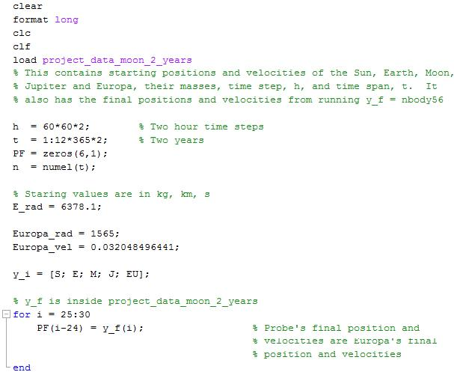
The Code

Slide 9
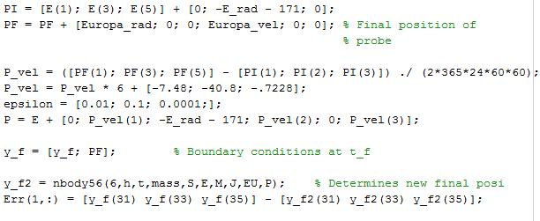
The Code

Slide 10
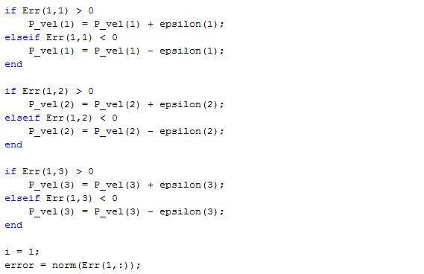
The Code

Slide 11
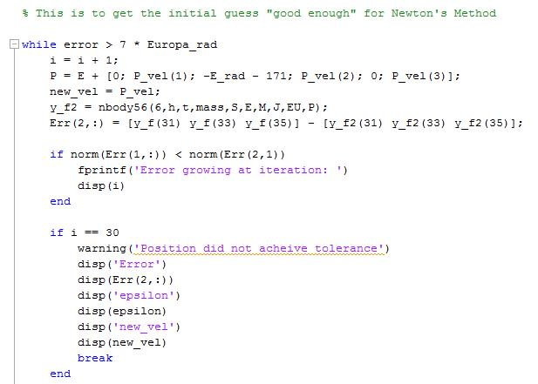
The Code
Bisection or Hallam’s Method?

Slide 12
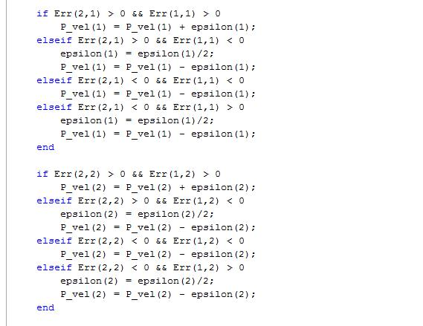
The Code

Slide 13
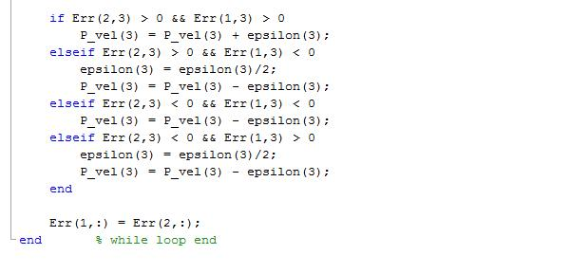
The Code

Slide 14
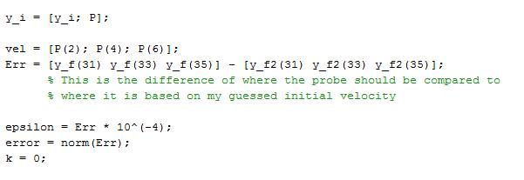
The Code

Slide 15
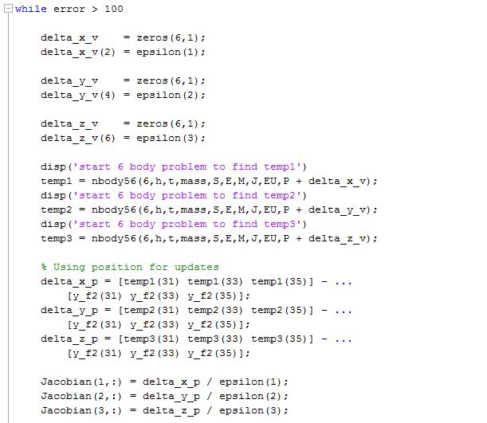
The Code
Newton’s Method

Slide 16
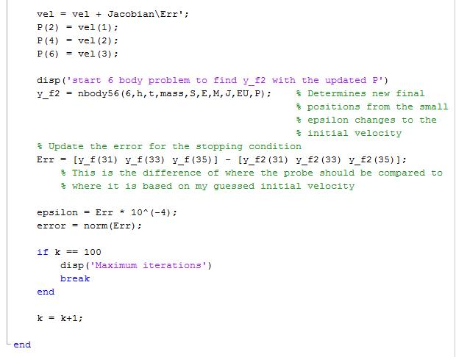
The Code

Slide 17
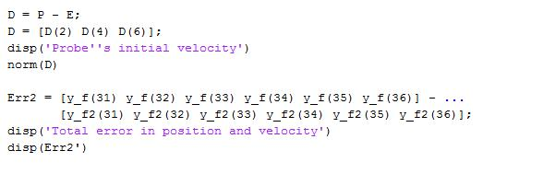
The Code

Slide 18
The Solution

Slide 19
The Solution

Slide 20
The Solution

Slide 21
The Solution

Slide 22
The Solution

Slide 23
Improvements
Celestial Mechanics
  Capture Dynamics
  Astrodynamics
    Gravity assist maneuvers
Analysis
Patience

Slide 24
Improvements
Capture Dynamics
  Only need to orbit Europa
Gravity Assist Maneuvers
  Probe’s initial velocity is 61.54 km/s = 137,700 miles / hour
  Atlas V’s top speed is 47,000 miles / hour
  “Slingshot” maneuvers around other planets can increase velocity

Slide 25
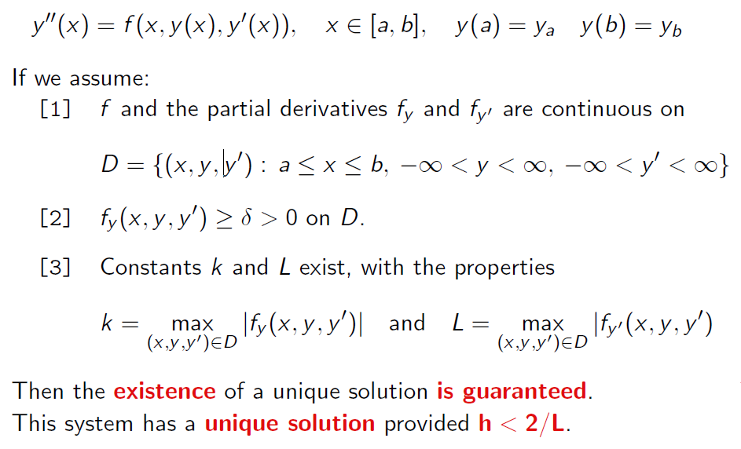
Improvements
Analysis

Slide 26
Improvements
Patience
  Choosing different launch windows and durations can lower velocity requirements and money.

Slide 27
Questions?

